Slide 1
In Situ Conformal 3D Printing for Targeted Repairs
Rohith Chintala, Brendan Cutick, Tyler Han, Elizabeth Myers, Eric Oh, Aidan Sandman-Long, Cynthia Sheng, Nathan Spicer-Davis
Team PRINT
Mentor: Dr. Steven Mitchell
Notes:
Hello everyone! In this presentation, we’ll be covering our poster for our project, “In Situ Conformal 3D Printing for Targeted Repairs”

Slide 2

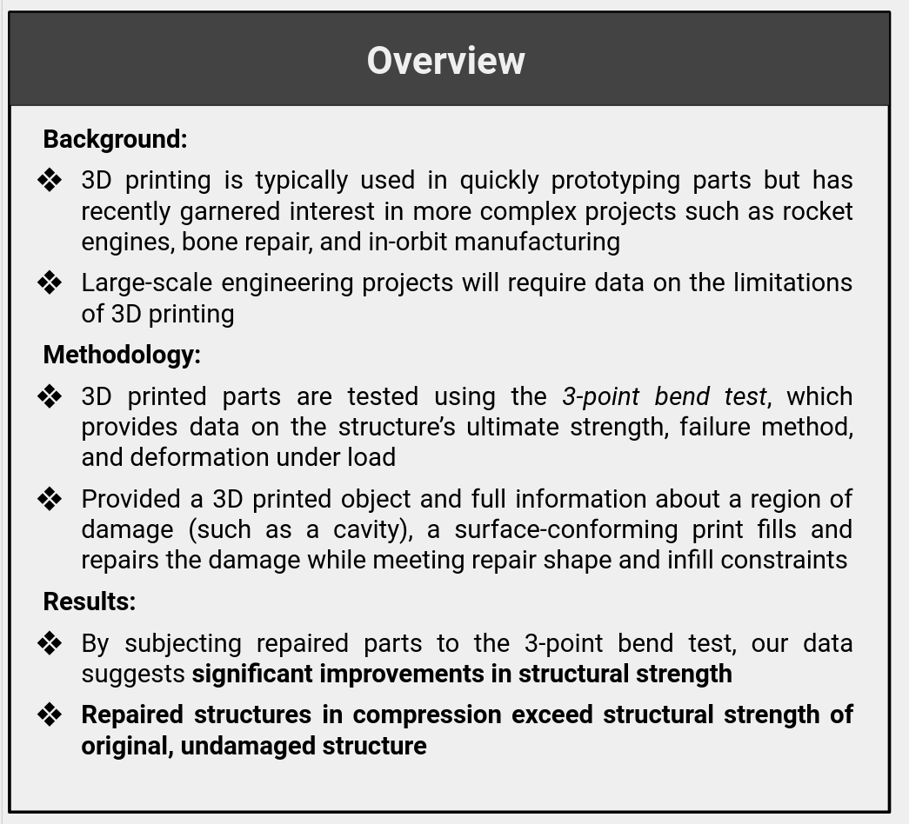
Notes:
Tyler
3D printing is typically used by hobbyists or for quickly prototyping parts, but the technology has also recently garnered interest in more complex projects like rocket engines, bone repair, and manufacturing in space. For this reason, reparative printing is gaining attention as a potential solution for maintaining the health of these projects’ over time in addition to more general repair applications.
Our primary research question is “How effective is 3D printed structures with conformal 3D printing?” Where conformal 3D printing is a method which allows for printing on non-planar surfaces.

Slide 3
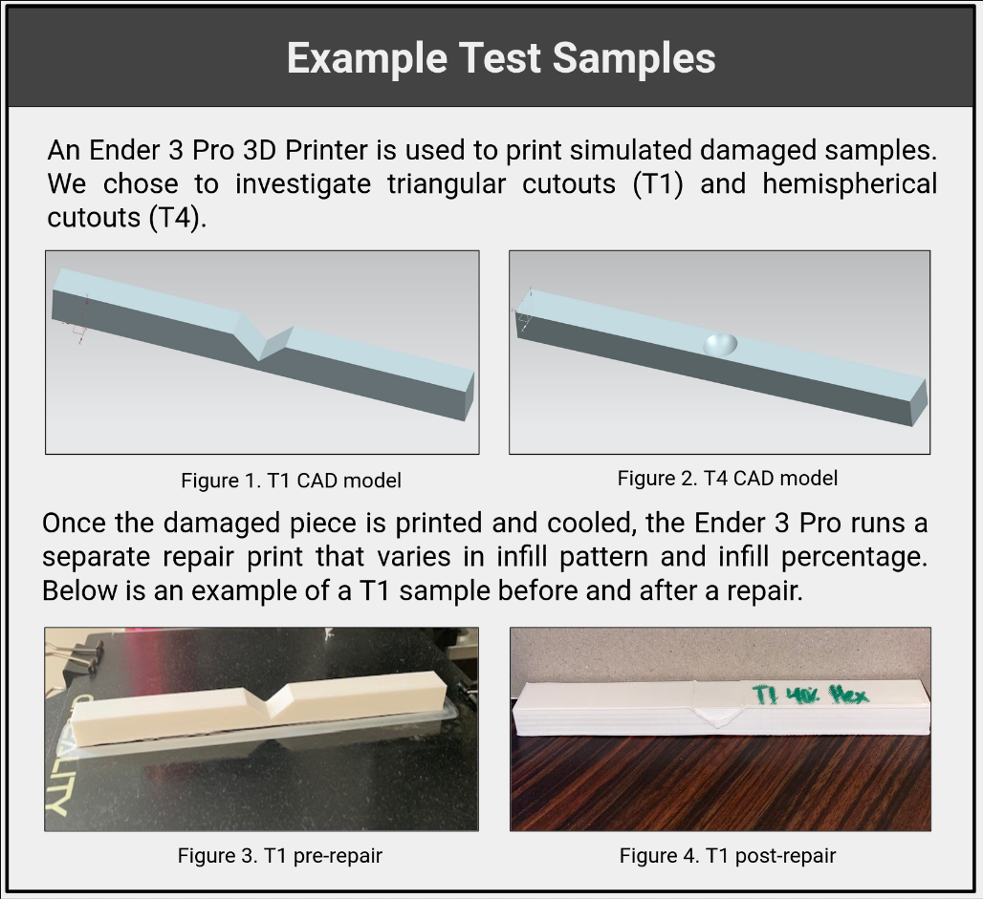
Notes:
Aidan

Slide 4
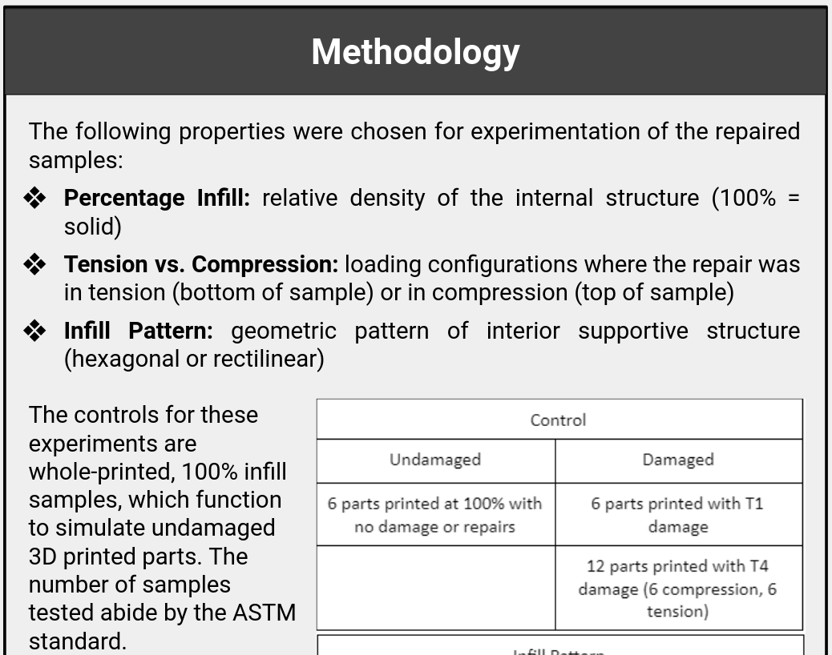
Notes:
Rohith

Slide 5
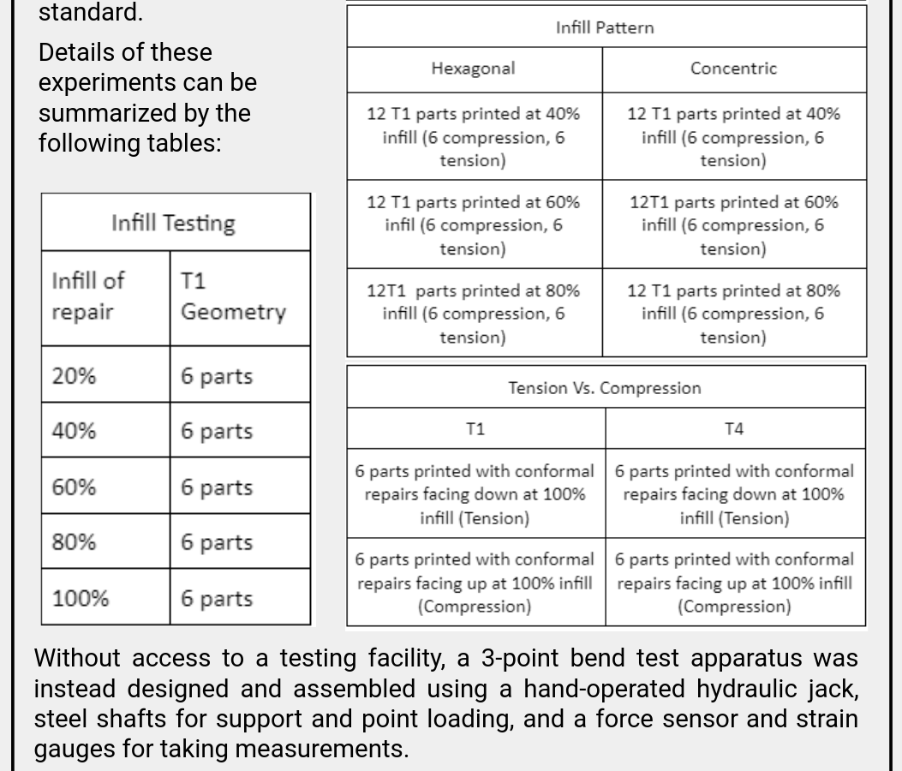
Notes:
Rohith

Slide 6
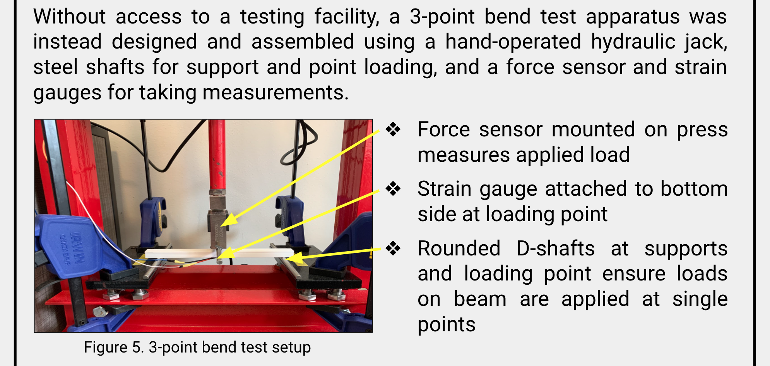
Notes:
Eric

Slide 7
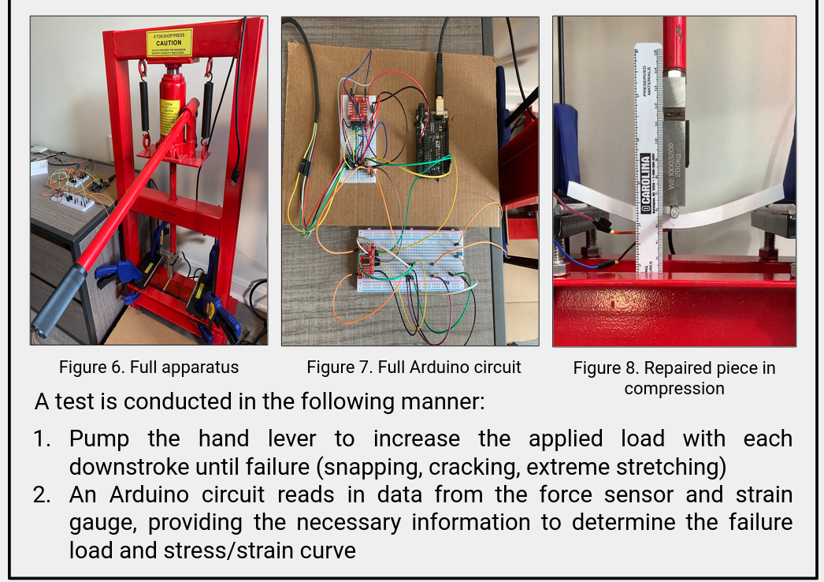
Notes:
Eric

Slide 8
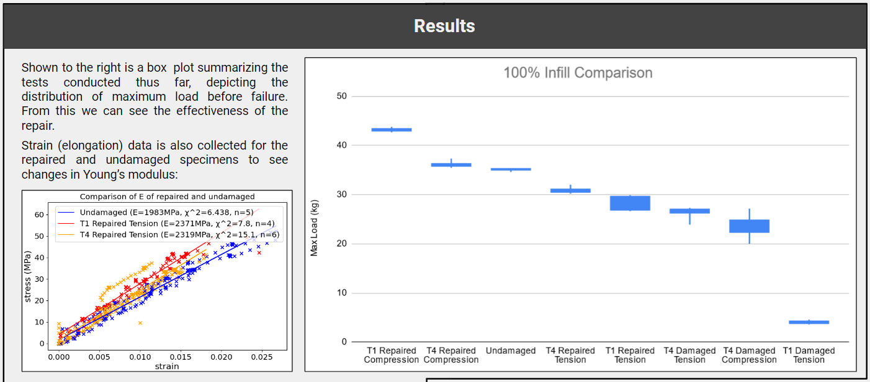
Notes:
Nathan
Now we will discuss the results from the data we have gathered. Thos most prominent data is on the graph on the right that shows the difference in load that the different specimens were able to carry. This shows how the repaired samples are able to hold more than the damaged samples.
We also took strain data when possible, and were able to see that the young’s modulus is slightly higher after repair than before.

Slide 9
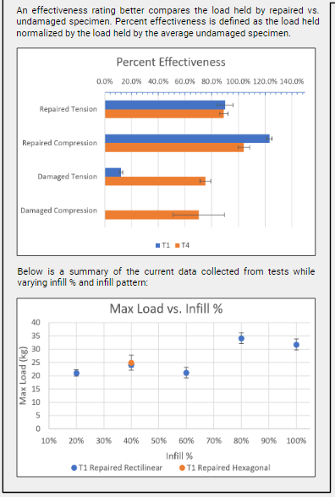
Notes:
Nathan
To rank how effective the different samples are compared to the undamaged samples, we generate the percent effectiveness based on max load held. The closer to 100% or higher the better. As you can see, when the repair is in compression it actually outperforms the undamaged samples.
Finally we have begun looking into the differences caused by altering infill pattern and percent infill. This data is incomplete and we are continuing to take more data to see any patterns.

Slide 10
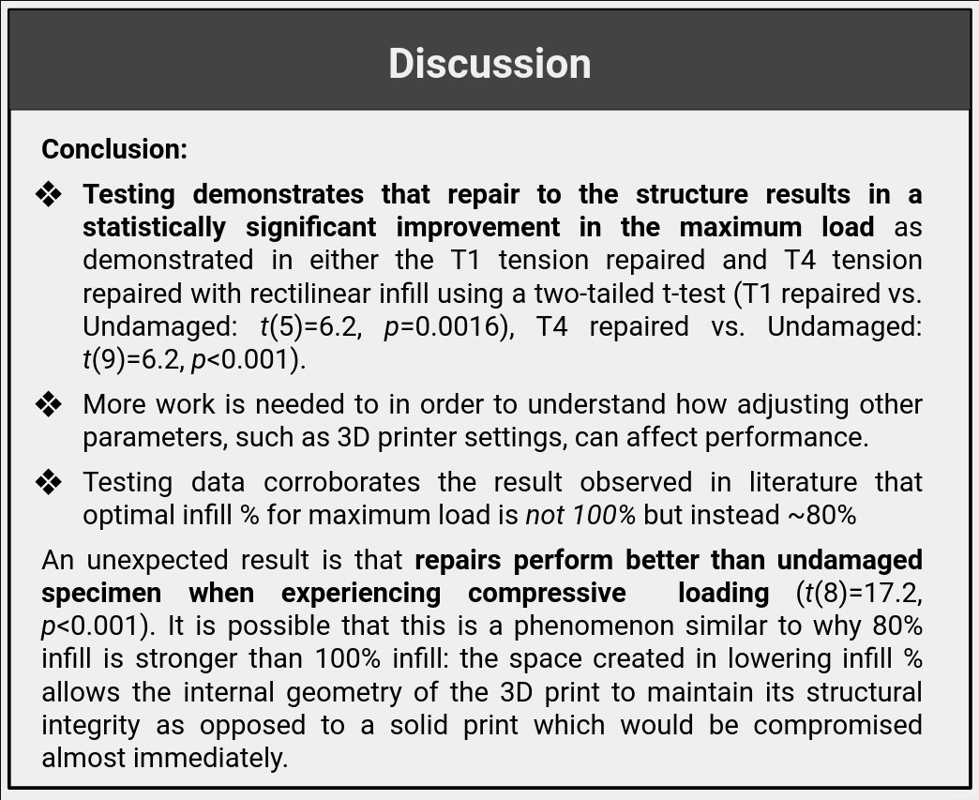
Notes:
Nathan
From our results we are able to see that repair causes a statistically significant improvement in maximum load heald compared to the damaged samples.
We will need more data to figure out what repairs improve damaged the most, and how to best optimize it.
We also found preliminarily that 80% infill is optimal instead of 100%, as other literature has shown.
An unexpected result that we found is that when the repairs are in compression, they actually hold more load than the undamaged samples. More research needs to go into finding why this is the case.

Slide 11
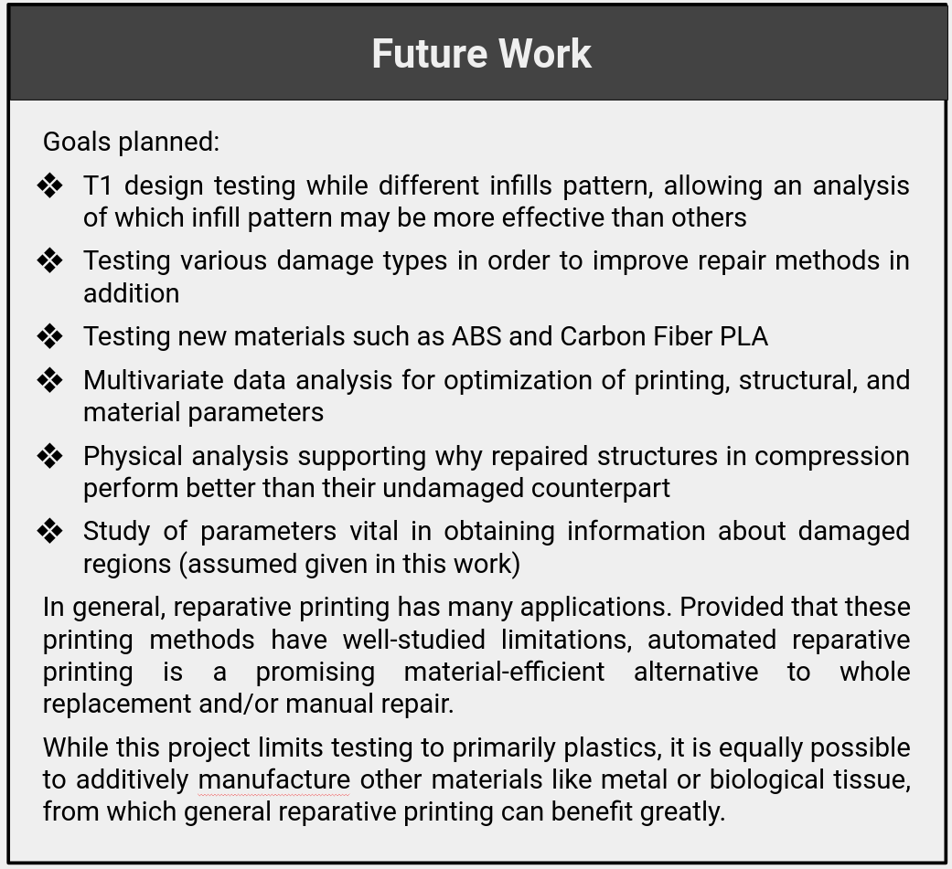
Notes:
Cynthia

